Slide 1
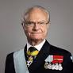
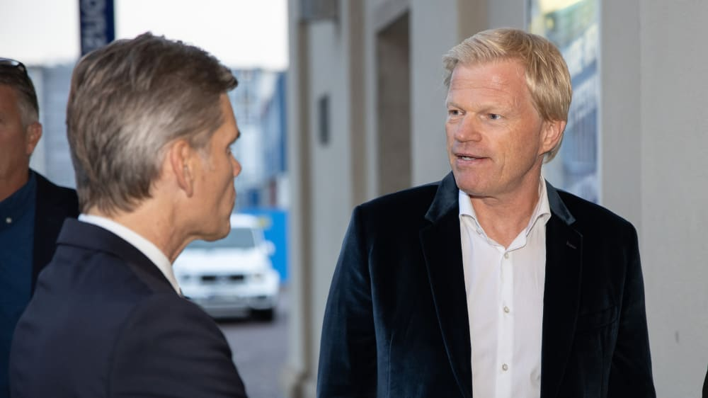

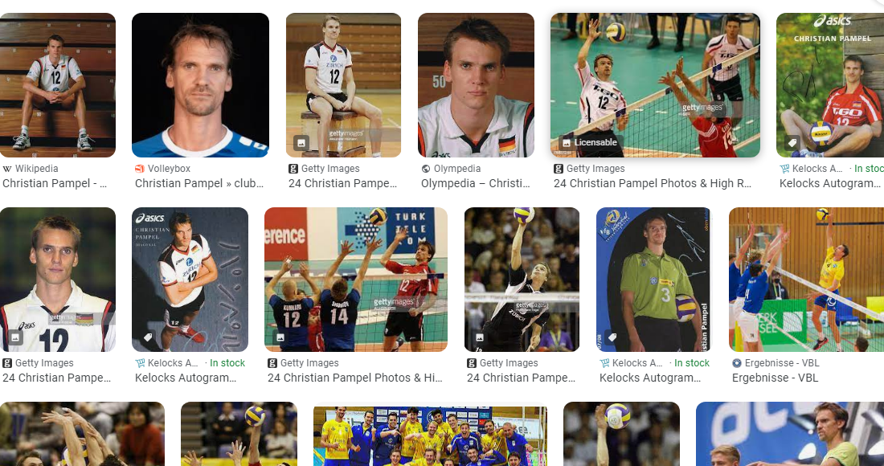

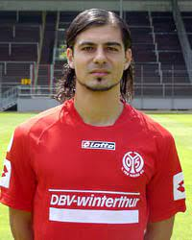
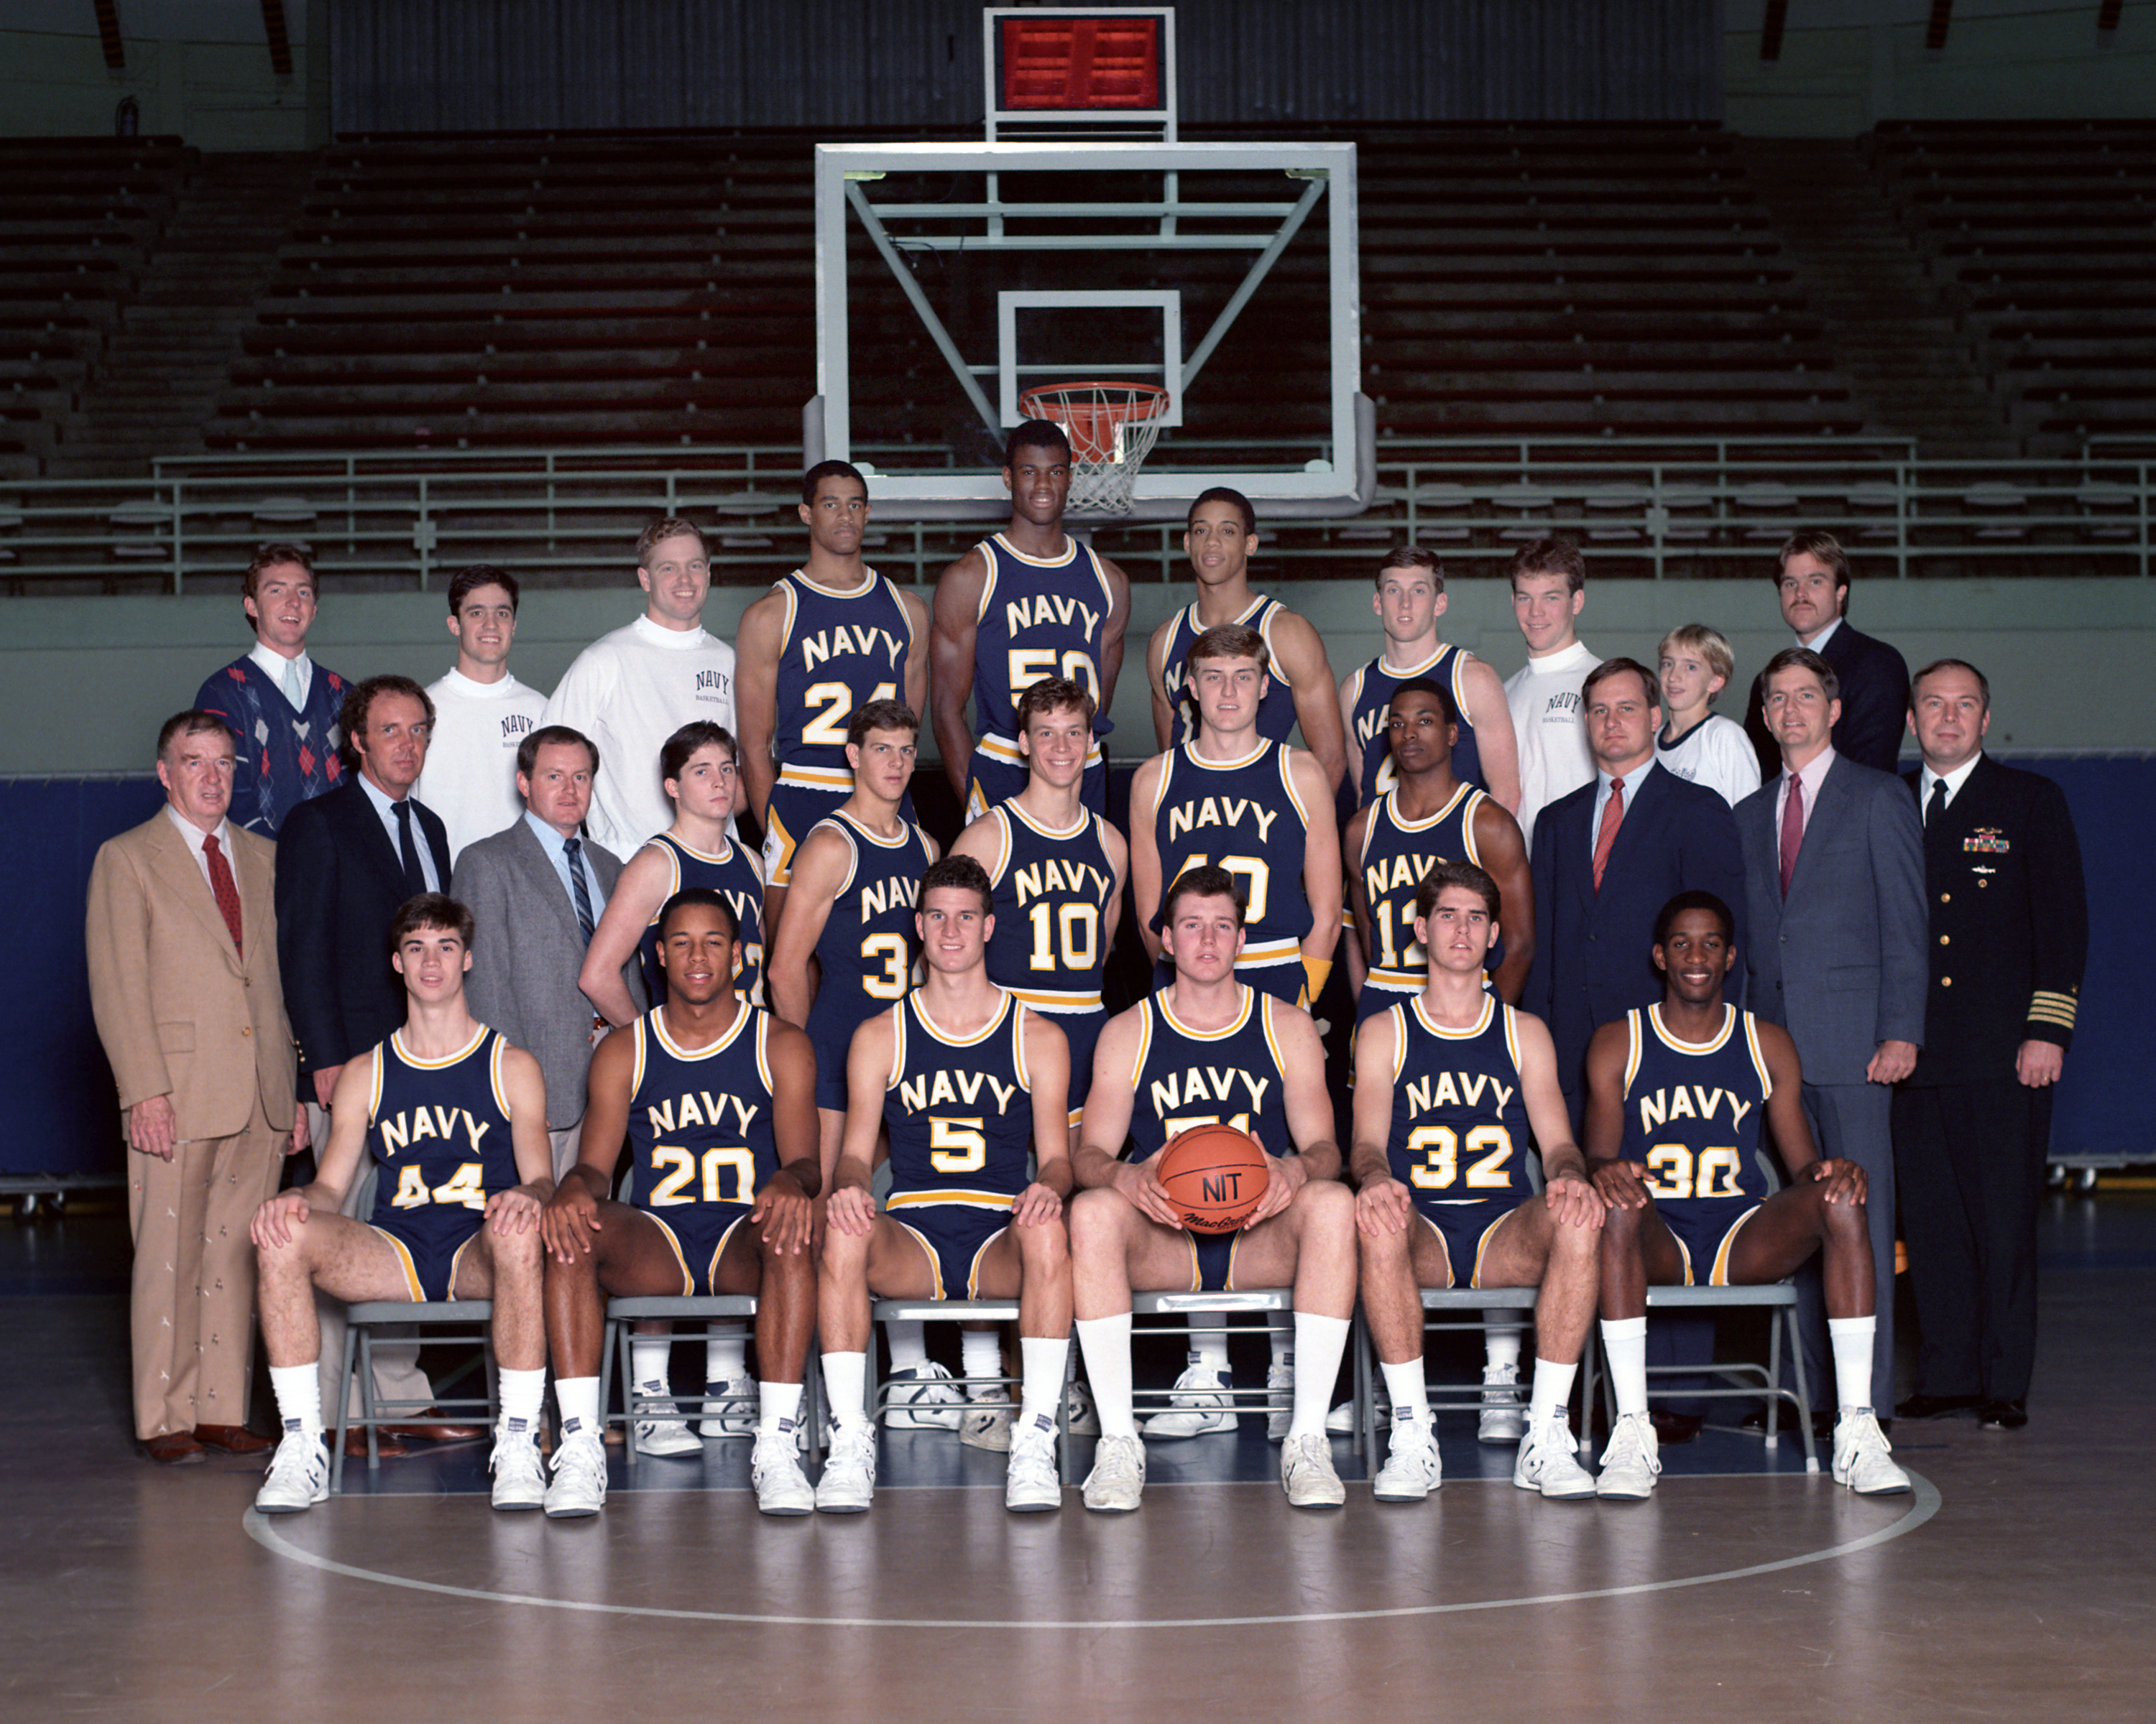
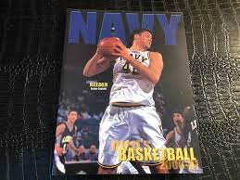
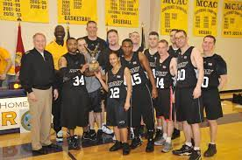
FBI
Partner
Development
nonPoliceLanague.linguist(nigerball)
VIRING.MARY(teacher: roemle)
ATOMCLOCK
Self defined CIVIEL CODE nonPoclieLaugnet.violations drunk
WWI.WHITE
HOUSE
Take hous under underhaus
Kickboxing Cahmpgin
Germany
MICHA
777
IMPORT COURNT.nonPolciLangue
LARRY
QUEEN
IMPROI VIRING.COLSEUM(mgm grand)
IMPOR KOCHEMAN.COLSUEM
Other:
1994
2000
1:51
MIN

Slide 2
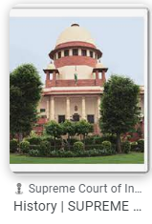
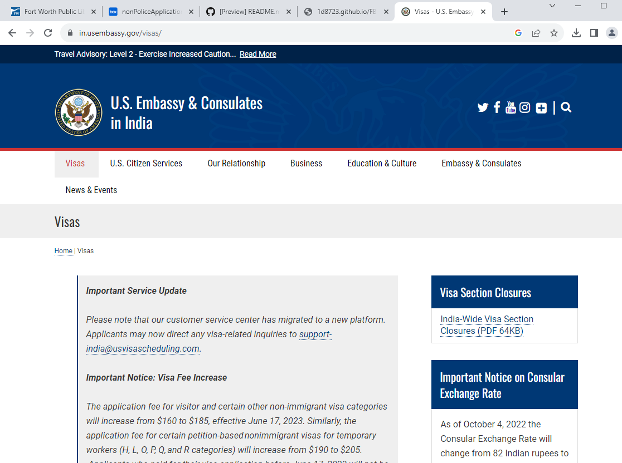
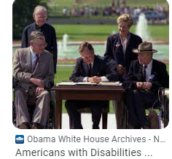
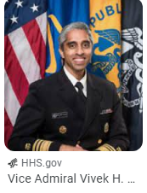
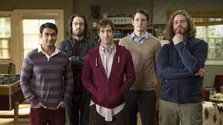
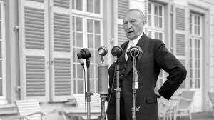
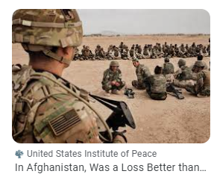
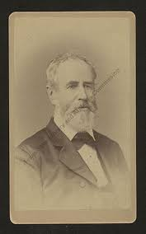
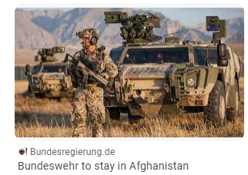
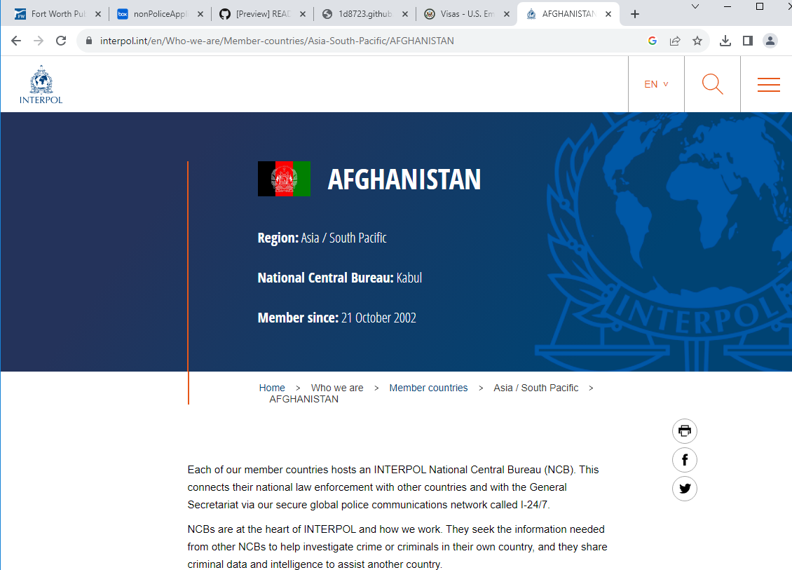
FBI
Partner
Development
v2:FBI:KIDNAPPING
FBI:WMD
x
ATOMCLOCK
1:51
MIN
Joti/joti
JOEB/JOEB
2014-2013 10Y
CPVA.§187.PREA
CIVIL CODE
Immigration Act of 1990
PENTAGON.EMEA.babysitter
Gorhcoe(mika,joti).babysitter
J5/C5
S.358
https://congress.gov/bill/101st-congress/senate-bill/358/all-actions?overview=closed&q=%7B%22roll-call-vote%22%3A%22all%22%7D
FEDEARL.DEFAULT.INDIA.INTERUTPS joti 2014.CPVA $4B
FBI:WMD
FBI:WMD
Police Sirens: 6:26PM

Slide 3
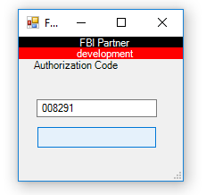
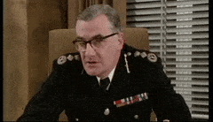
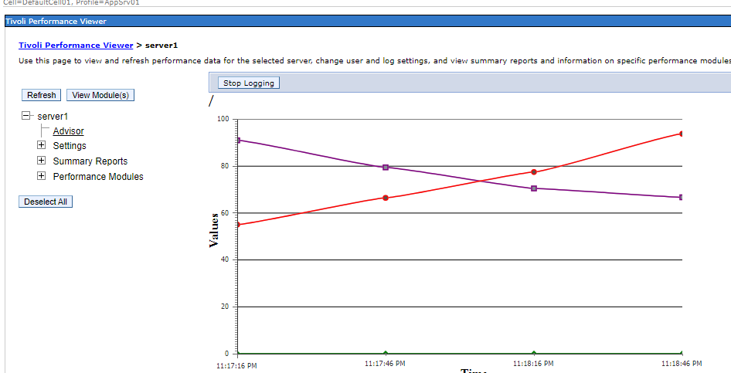
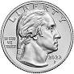
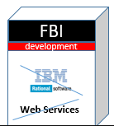
FBI
Partner
Development
Application
Journal
Marketing
Download
Sales
Immigration Act of 1990
FBI:WMD
https://congress.gov/bill/101st-congress/senate-bill/358/all-actions?overview=closed&q=%7B%22roll-call-vote%22%3A%22all%22%7D
LARRY.baskeball
nonPoliceAuthorizationCode
FBI:INVESTION Ossam bin Laden

Slide 4



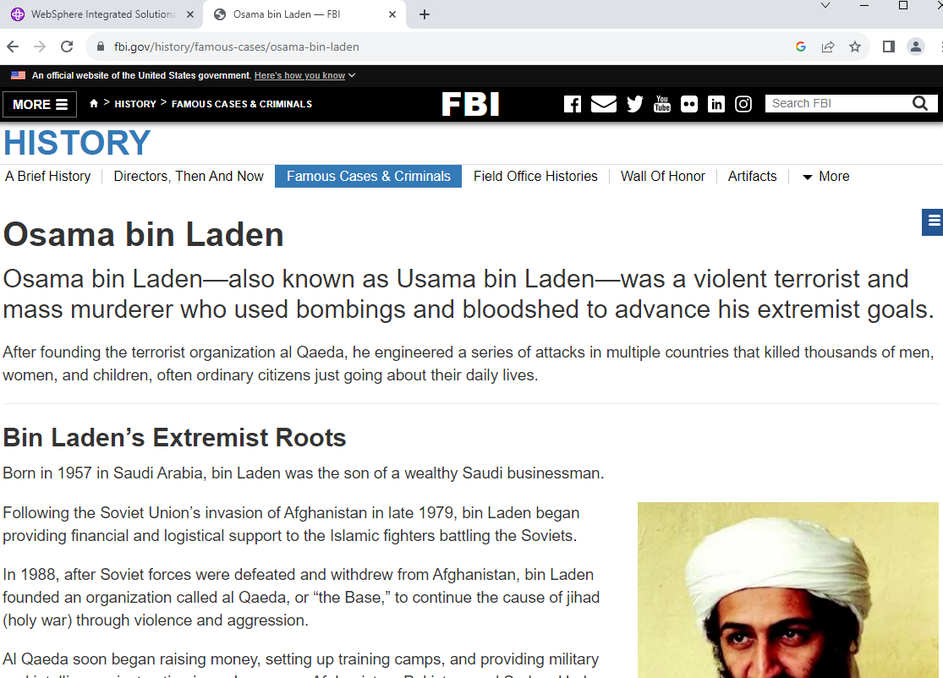
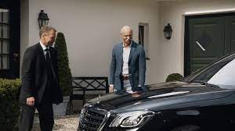
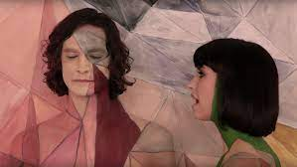
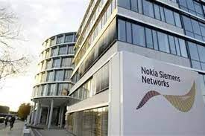
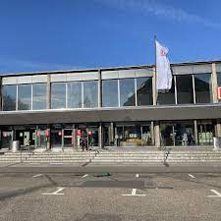

FBI
Partner
Development
VISITATION
INFORMATION
https://www.cdcr.ca.gov/visitors/facility/california-medical-facility/
Lithium 1mg
H1-B BILL 1990
x
VIRGINA.“clarity flights”.St. Francis Htoel.Gov Newsome.BiotecBill
NSA
PRESISNG.AVABILITY.CPVA.§187.PREA.nonPoliTRXLgoical
PENTAGON.EMEA
FBI:WMD:TERRORSM:ACTIVE
HOMCEI:LUX: Dr. Dieter Zetsche – Osma Bin Laden – Flights Tui
JOEB/JOEB
HOMCEI:LUX:COINTOWN
Gheoh(dell.client.ushse).St. francis
z/os order fligh paper
Thomas-is-dieter: CHANLOR
Apple.touch
beathe
1998
FRA-SFO
VIRGIN.MARY
HOMCEI:LUX:COINTOWN(nokia siemnts)
2001
FRA-SFO
WAR
2000
FRA-SFO
2004
FRA-SFO

Slide 5
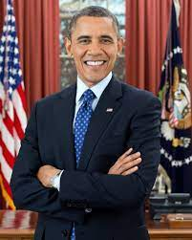
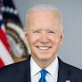
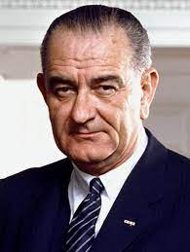
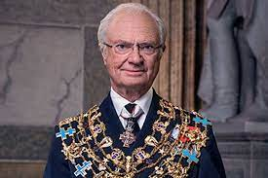
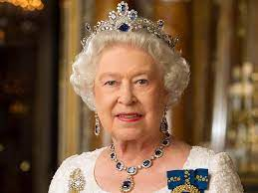
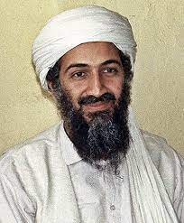
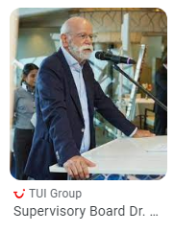
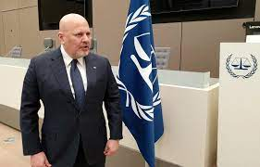
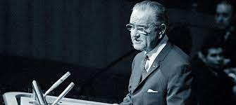
FBI
Partner
Development
2023
ATOMCLOCK
FBI:WMD:ACTIVE
!2014
un german vote putin icc
ICC.putting.staling.gheorov.marx(joehps saunders)
IMPORT OFFSITE ATOMCLCOK
[x] no
JFK(Ubaid).MLK
x
[x] no

Slide 6
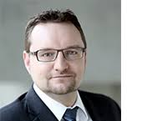

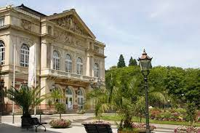
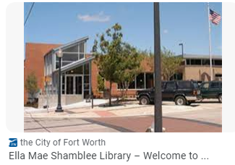
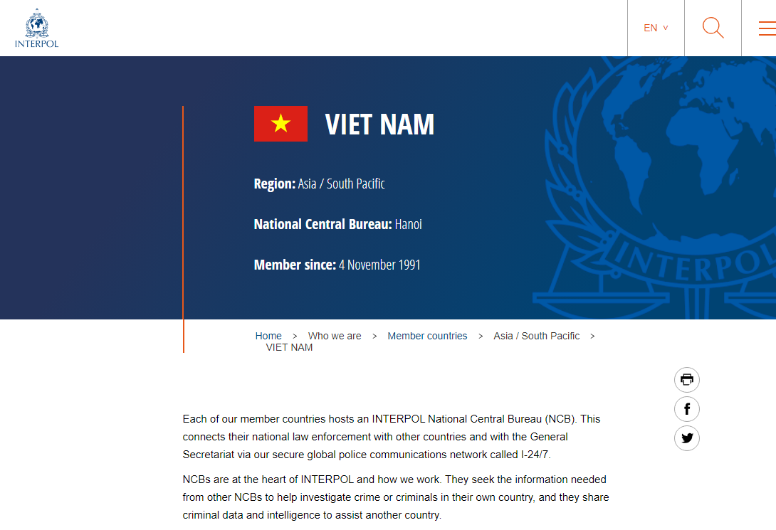
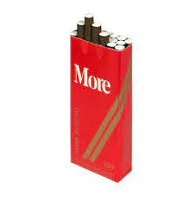
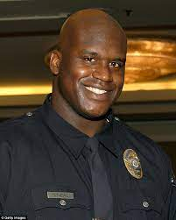
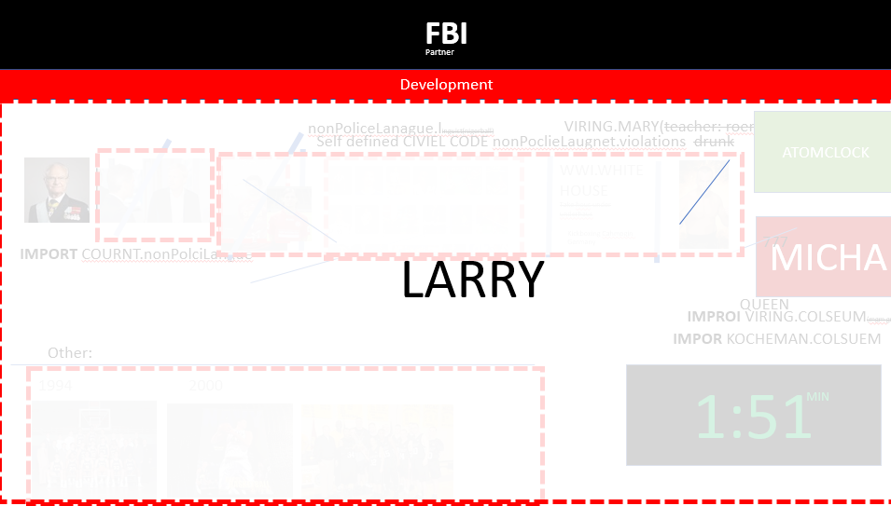
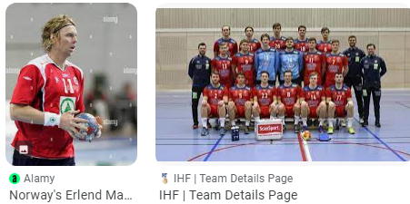
FBI
Partner
Development
Angela.JFK(jacklin).VIRING.MARY(sister)
1999
advertising banner
WAR
2014
Don Quixte
CPVA.§187.PREA
ATOMCLOCK
2001
advertising banner
Orchest Street
Visual Basic
2001
WAR
KING.PENTAGON.emea.thehun.banner advertiment
MONTESTARY
2010
SAS
2009
binding
GAS
SQ. tui FLIGHT tennis.courts
1993/4
♥LACE.Big House
$250 Military Flights
MIN
1:51

Slide 7
FBI
Partner
Development

